Slide 1


CAMERA BASED INDOOR POSITIONING SYSTEM USING RASPBERRY PI
AUTHOR – Cashin Green Martin Clement Joe
Reg No - 200653343
PROJECT SUPERVISOR: Dr Francis Franklin

Slide 2
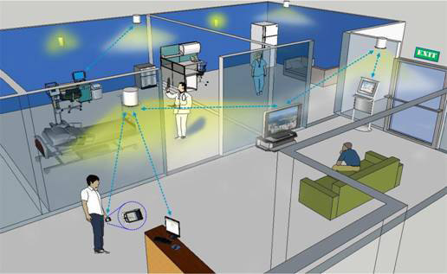
Indoor Positioning System
Indoor Positioning system (IPS) is a system just like GPS which provides an indoor location to track objects and people inside a building.
There are different types of nodes for Indoor positioning System. The most common are
A. Wi-Fi Based Systems
B. Ultra-Wide band Systems
C. Acoustic Systems
D. Infrared Systems
E. Inertial positioning System

Slide 3
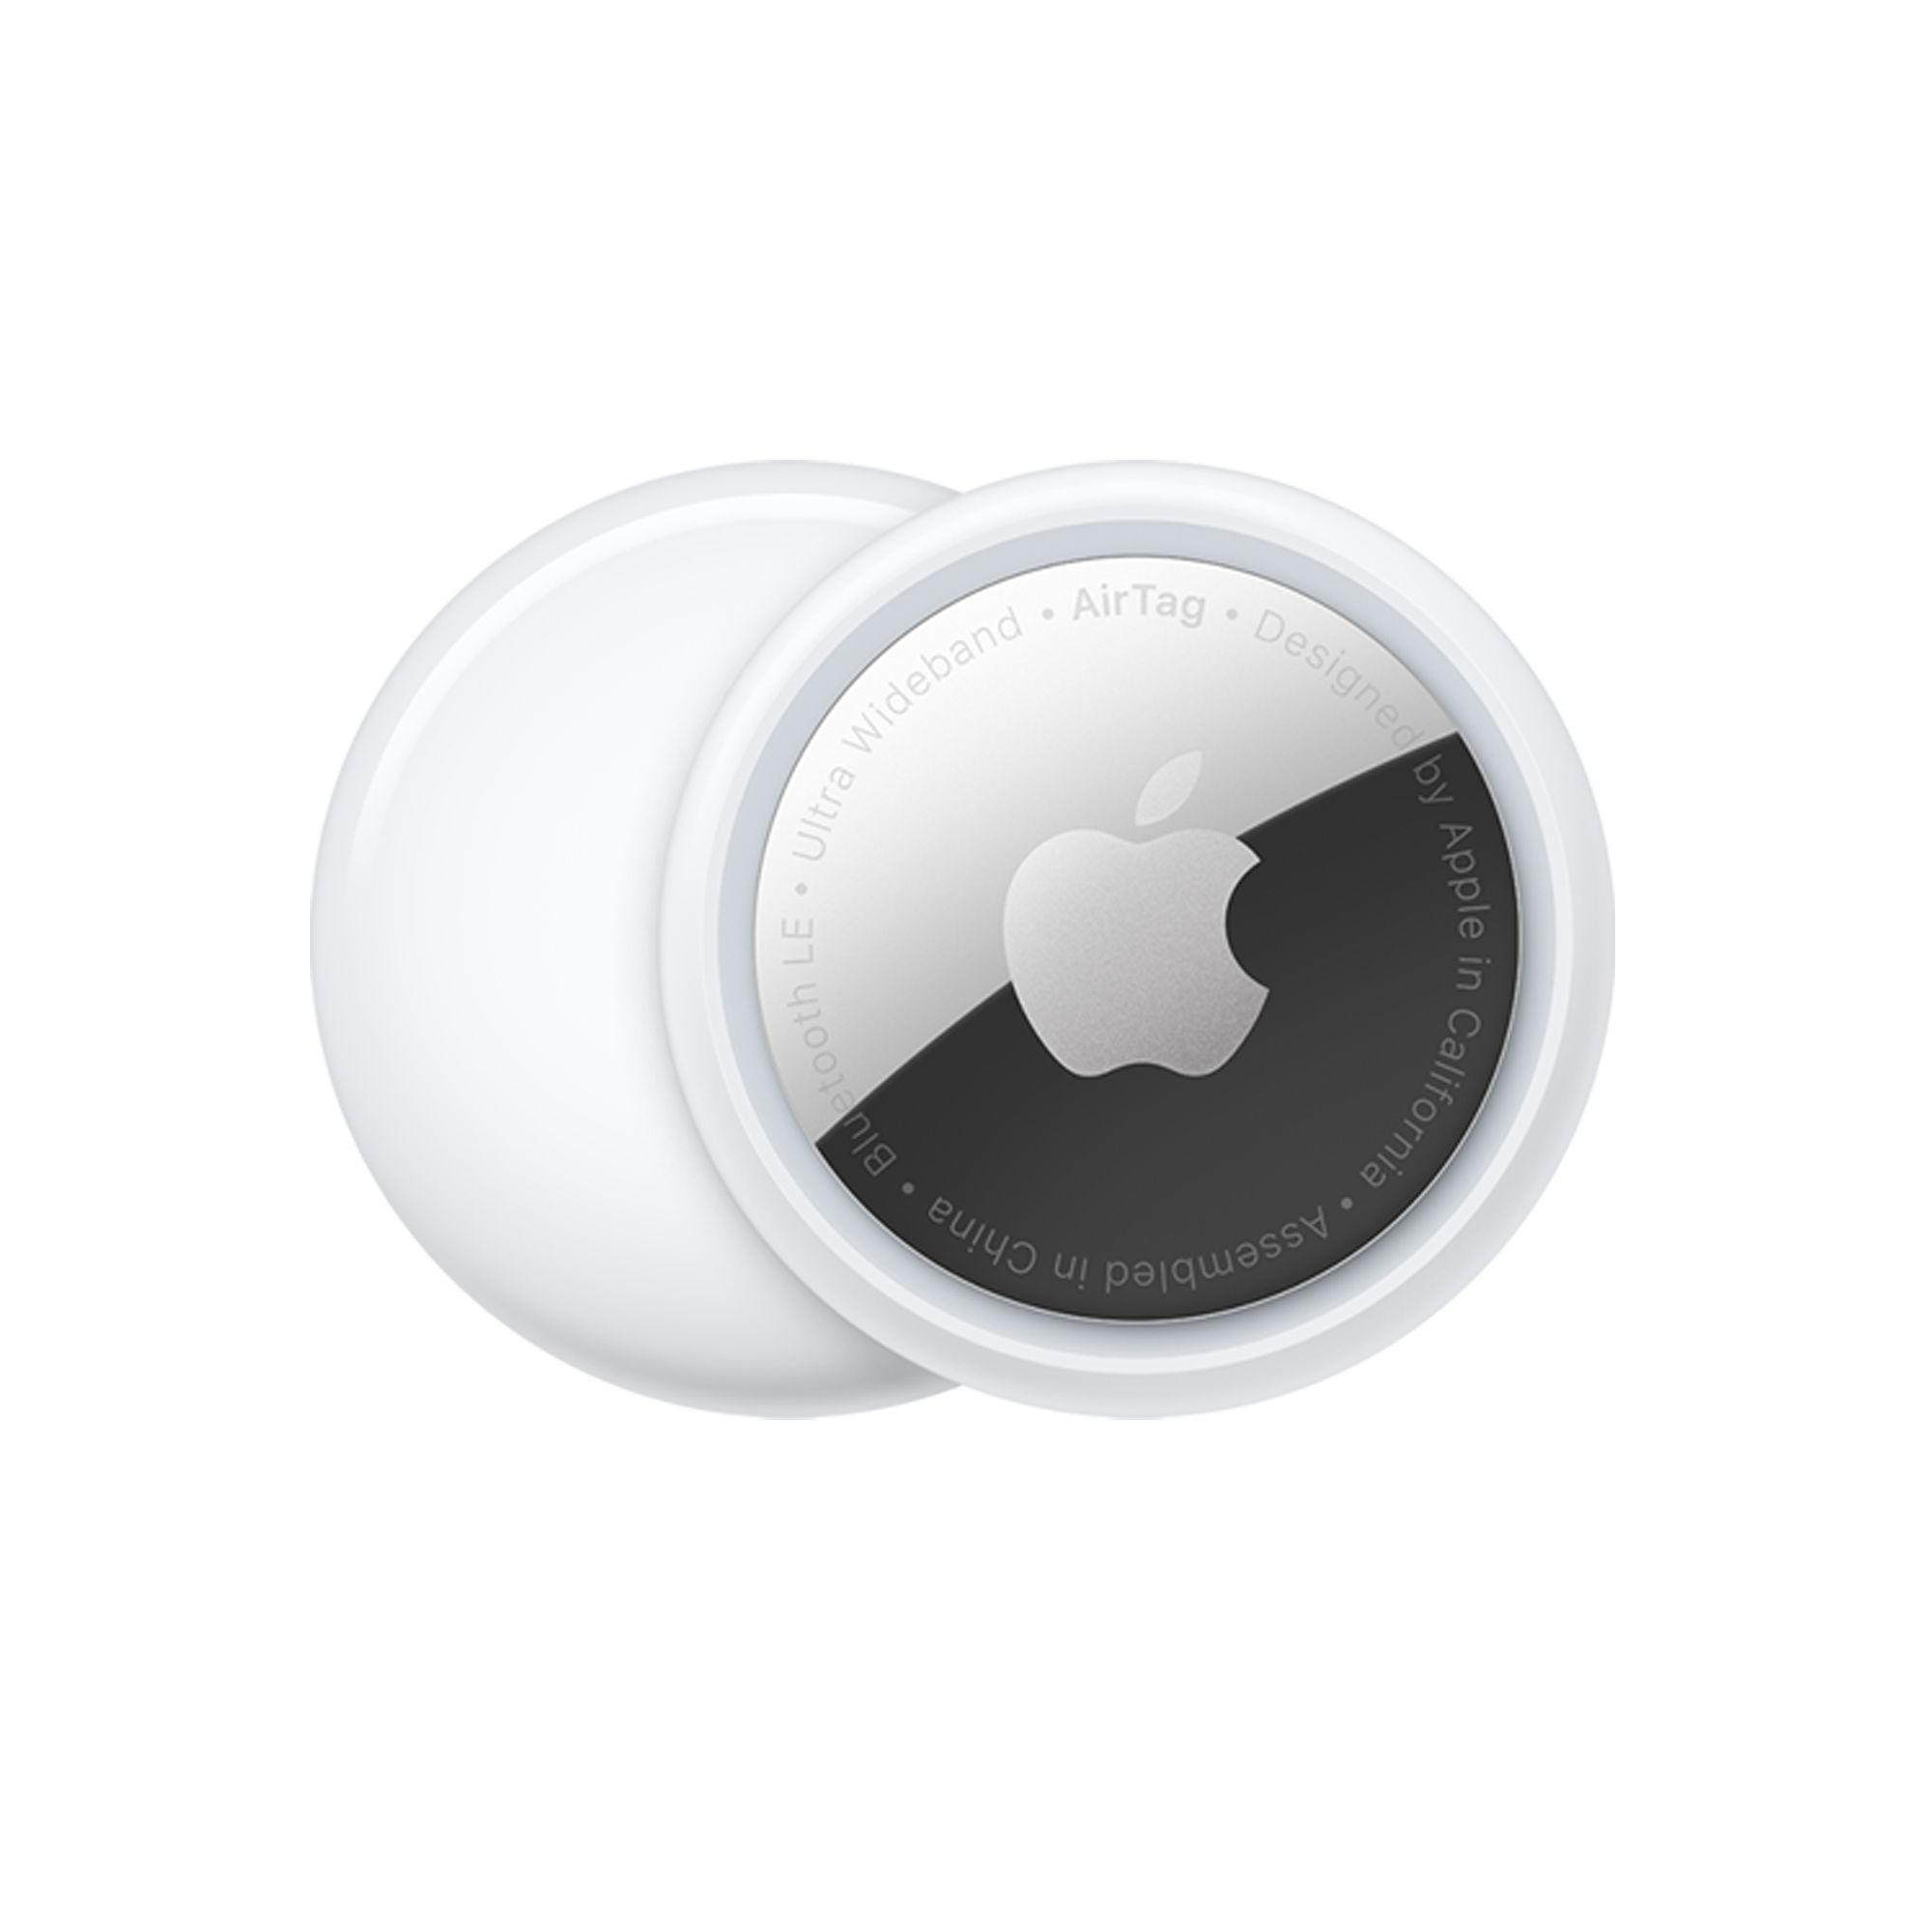
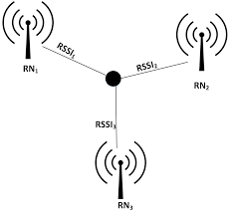
Existing IPS technology
Types
Wi-Fi based system
Bluetooth based system
Radio-waves based system
Anchor points?
The source of each transmitter that locates the device/ Body.

Slide 4
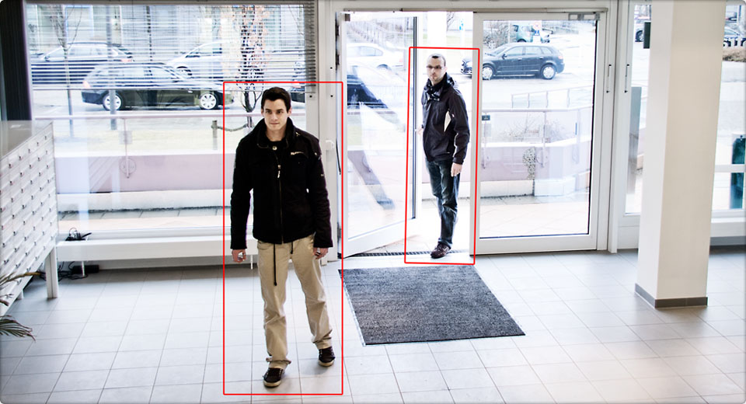
Indoor positioning system using camera?
Determine the position of an object using camera.
Distance measurement is the novel technology used in this topic.

Slide 5
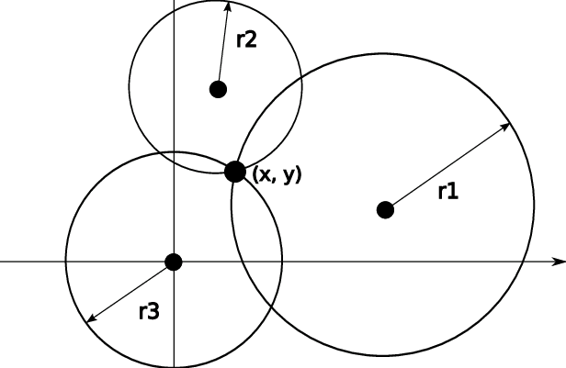
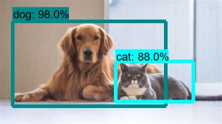
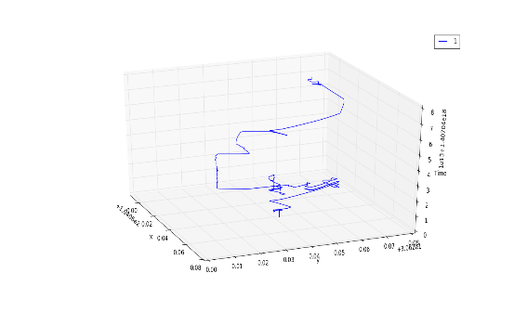
Process flow chart
Object Detection
Distance Calculation
OpenCV
TensorFlow
Trilateration
Triangulation
Coordinates

Slide 6
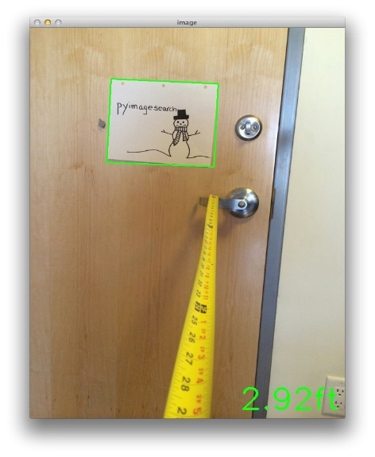
How to find the distance between the camera and the object ?
The solution is Computer vision
Computer Vision is the science of computers and software systems that can recognize and understand images and scenes. Computer Vision is also composed of various aspects such as image recognition, object detection, image generation, image super-resolution and more.
Three cameras will capture an object to be tracked from three axis.
In order to determine the distance from our camera to a known object or marker, we are going to utilize triangle similarity.
Knowing the focal length of the camera ‘F’
Width of the object ‘W’
Pixel value of the camera ‘P’
The Formula to get the distance is given below
F = (P x D) / W [1]
Once yolo identifies the object, the distance is measured
Once the distance is measured between the object and the camera the coordinates are calculated using the equation 3

Slide 7
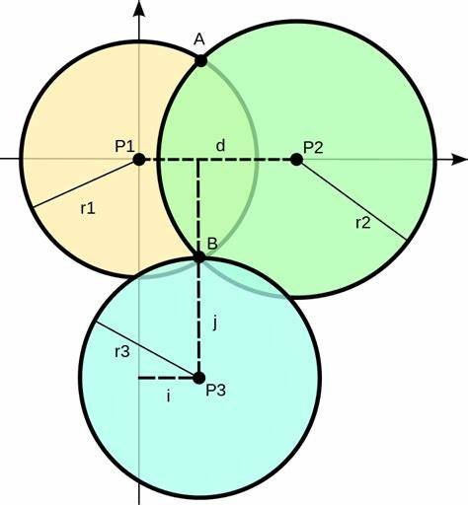
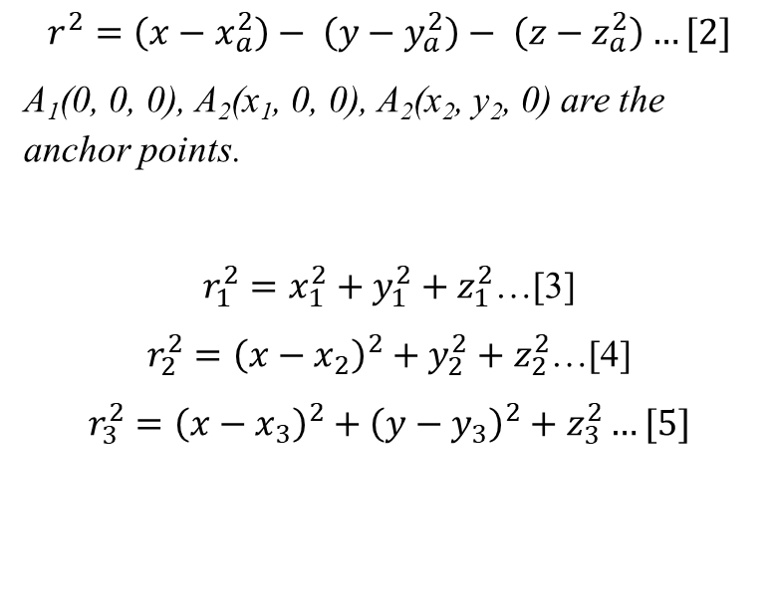
Trilateration
General circle formula
$$r^{2}=\left(x−x_{a}^{2}\right)− \left(y−y_{a}^{2}\right)− \left(z−z_{a}^{2}\right)…[2]$$
A₁(0, 0, 0), A₂(x₁, 0, 0), A₂(x₂, y₂, 0) are the anchor points.
$r_{1}^{2}=x_{1}^{2}+y_{1}^{2}+z_{1}^{2}$…[3]
$r_{2}^{2}={\left(x−x_{2}\right)}^{2}+y_{2}^{2}+z_{2}^{2}$…[4]
$r_{3}^{2}={\left(x−x_{3}\right)}^{2}+{\left(y−y_{3}\right)}^{2}+z_{3}^{2}…[5]$

Slide 8
Objectives
Model Selection
Creation of dataset
Training the dataset
Creation of checkpoints for trained model
Object Detection using OpenCV
Extracting the dimensions of the bounding box
Calculating the distance of the object
Trilateration

Slide 9
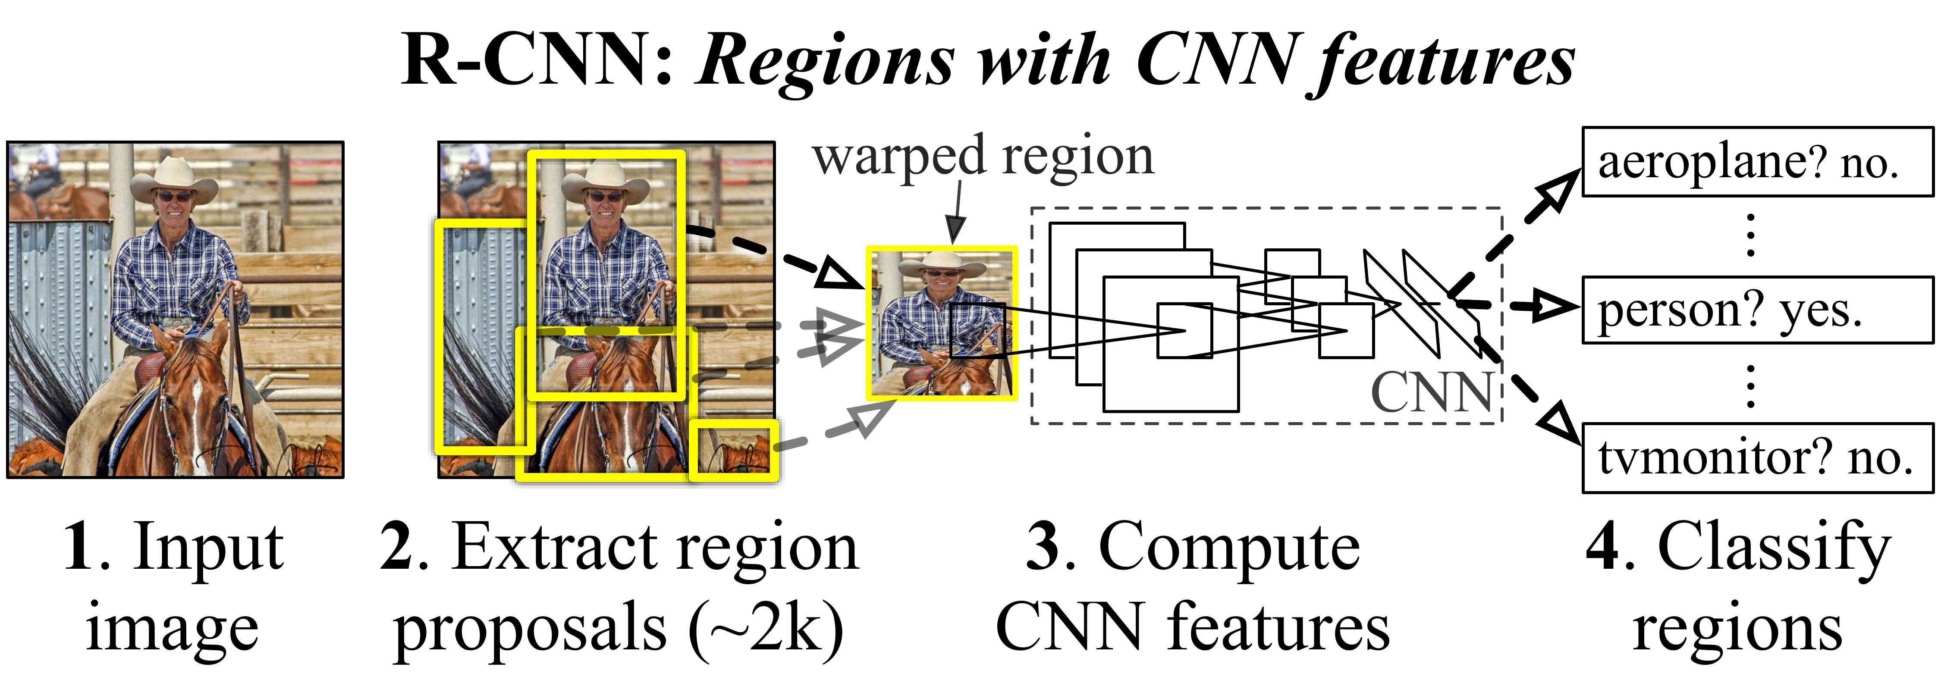
Model architecture?
TensorFlow 2 Model Zoo – SSD MobileNet v2 320x320
https://github.com/tensorflow/models/blob/master/research/object_detection/g3doc/tf2_detection_zoo.md

Slide 10
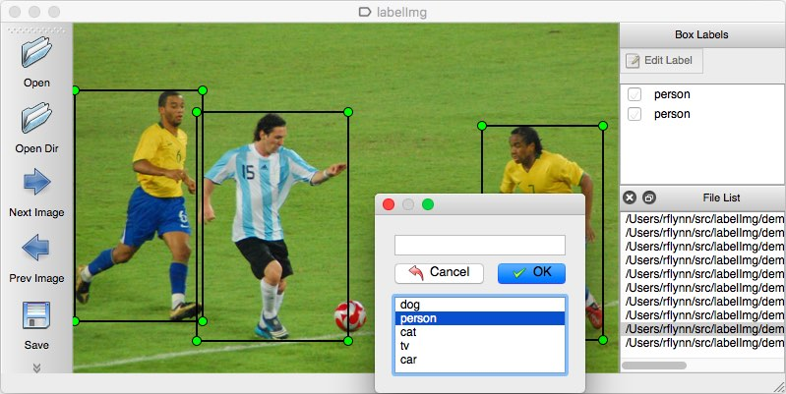
Creation of Dataset
The dataset is created by taking the samples of images that contains images.
The library used is labelimg.
It allows us to create the region for the R-CNN.

Slide 11
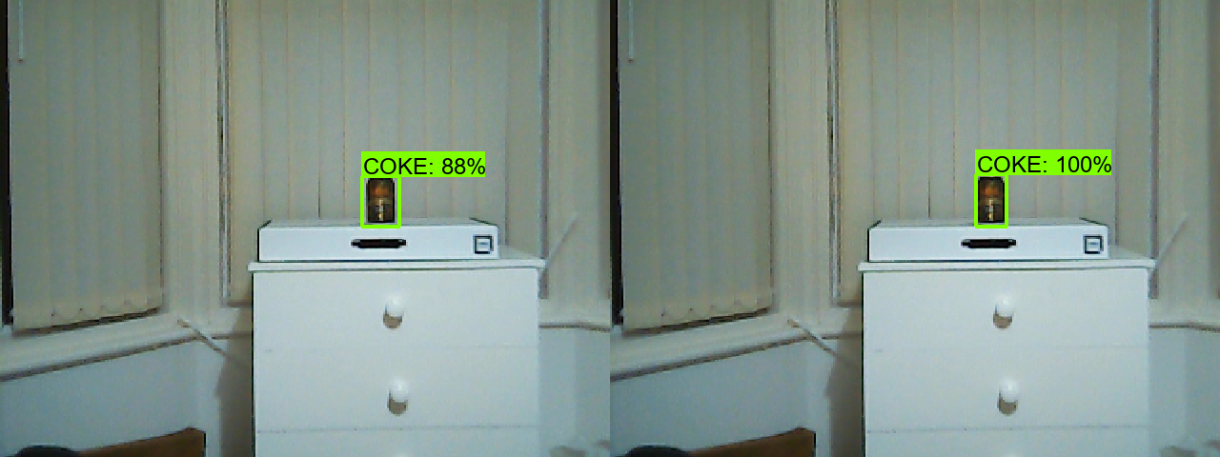
Object Detection
Tensor output
Bounding box (YOLO) creation
The dimensions of the bounding box can be extracted
These values are taken and manipulated in equation[1].

Slide 12
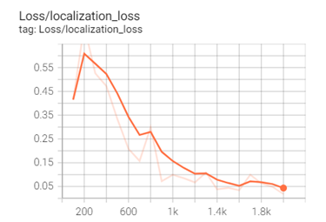
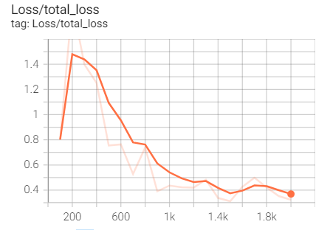
Accuracy of the model
For object detection
For the overall Dataset.

Slide 13
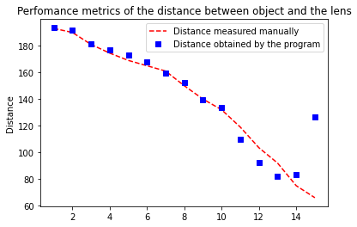
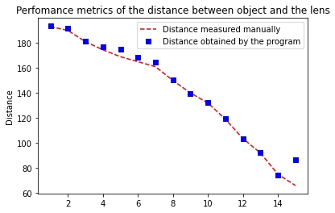
Results
The results are obtained, by plotting the values obtained vs values measured.

Slide 14
Values obtained from trilateration algorithm.
TABLE I
Values of the Coordinates X and Y calculated using trilateration, by the distances measured using the three cameras
CAMERA 1 | CAMERA 2 | CAMERA 3 | X | Y
82.10 | 79.90 | 67.33 | 51.78 | 57.46
91.11 | 67.62 | 85 | 68.64 | 18
94.79 | 80.71 | 71.46 | 62.35 | 44.67
77.39 | 67.93 | 79.31 | 48.49 | 61.17
66.31 | 82.78 | 66 | 37.72 | 74.75
93.22 | 80.83 | 88.13 | 60.78 | 33.04
79.91 | 88 | 59.31 | 43.21 | 77.91

Slide 15
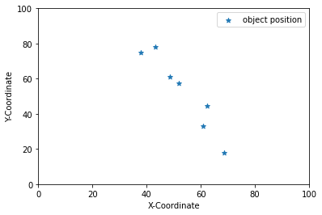
Results of coordinates
Anchor points:
(0,0,10cm), (0,100cm,10cm),
(100cm, 100cm, 10cm)

Slide 16
Advantages and Drawbacks?
Advantages
It can be made using commercially available products
Only few anchor points is required to find distance.
Precision increases as more data is given to machine learn.
Disadvantages
The viewing angle of the camera
The data obtained should be from different directions of the object.

Slide 17
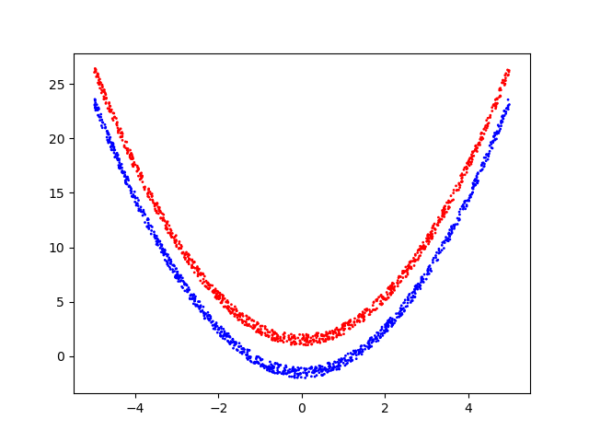
Future scope
The plotted values are machine learned and the values can be used to feed in a robot to move in a closed environment.
This project helps in industry 4.0 to build a feed back control for AGVs
This may supersede the current GPS technology.

Slide 18
Thank you

